Slide 1

Programming in Java String Handling
Lovely Professional University, Punjab

Slide 2
String
In java, String is basically an object that represents sequence of char values.
An array of characters works same as java string.
char[] ch={'j','a','v','a'};
String s=new String(ch);
is same as:
String s="java";

Slide 3
Introduction
Every string we create is actually an object of type String.
String constants are actually String objects.
System.out.println("This is a String, too");
Objects of type String are immutable.
Once a String object is created; its contents cannot be altered.
String Constant

Slide 4
Why String is Immutable or Final?
we can pass database URL as string for opening database connection,
we can open any file in Java by passing name of file as argument to File I/O classes.
In case if String is not immutable ,
this would lead serious security threat,
means some one can access to any file
for which he is not authorization and
then can change the file name
either deliberately or accidentally
and gain access of those file.

Slide 5
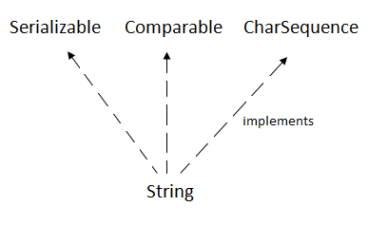
String Class
The java.lang.String class implements
Serializable,
Comparable and
CharSequence interfaces.

Slide 6
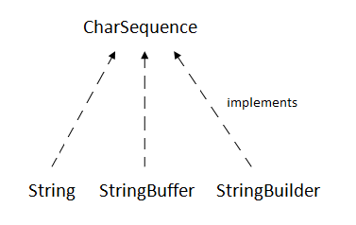
CharSequence Interface
The CharSequence interface is used to represent sequence of characters.
It is implemented by String, StringBuffer and StringBuilder classes.
It means, we can create string in java by using these 3 classes.

Slide 7
The java String is immutable i.e. it cannot be changed.
Whenever we change any string, a new instance is created.
For mutable string, you can use StringBuffer and StringBuilder classes.

Slide 8
Introduction
In java, 4 predefined classes are provided that either represent strings or provide functionality to manipulate them.
String
StringBuffer
StringBuilder
StringTokenizer
String, StringBuffer, and StringBuilder classes are defined in java.lang package and all are final.
All of them implement the CharSequence interface.

Slide 9
Important
String Objects are IMMUTABLE.
StringBuffer is MUTABLE and SYNCHRONIZED.
StringBuilder is MUTABLE and NON-SYNCHRONIZED.

Slide 10
How to create String object?
There are two ways to create String object:
By string literal
By new keyword

Slide 11
1) String Literal
Using double quotes. For Example:
String s="welcome";
Each time you create a string literal,
the JVM checks the string constant pool first.
If the string already exists in the pool,
a reference to the pooled instance is returned.
If string doesn't exist in the pool,
a new string instance is created and placed in the pool.
String s1="Welcome";
String s2="Welcome";
//will not create new instance

Slide 12
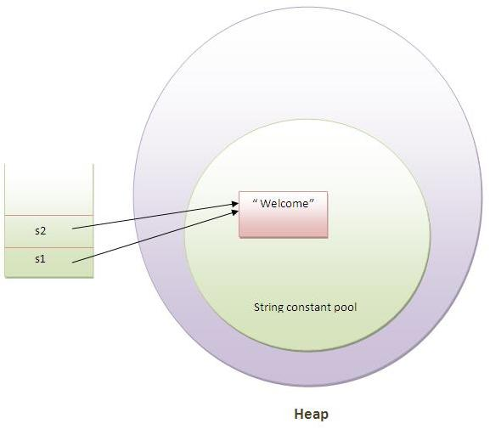
Note: String objects are stored in a special memory area known as string constant pool.

Slide 13
2) By new keyword
String s=new String("Welcome");
In such case,
JVM will create a new string object in normal(non pool) heap memory
The literal "Welcome" will be placed in the string constant pool.
The variable s will refer to the object in heap(non pool).

Slide 14
Java String Example
public class Test {
public static void main(String args[]) {
String s1 = "java"; //creating string by java string literal
char ch[] = {'s', 't', 'r', 'i', 'n', 'g', 's'};
String s2 = new String(ch); //converting char array to string
String s3 = new String("example"); // //by new keyword
System.out.println(s1);
System.out.println(s2);
System.out.println(s3);
}
}
java
strings
example
//s3.append("abc"); // error: variable s3 of type String

Slide 15
Why String Handling?
String handling is required to perform following operations on some string:
Compare two strings
Search for a substring
Concatenate two strings
Change the case of letters within a string

Slide 16
Creating String objects
class Test
{
public static void main(String args[])
{
String strOb1 = "Java";
String strOb2 = "Programming";
String strOb3 = strOb1 + " and " + strOb2;
System.out.println(strOb1);
System.out.println(strOb2);
System.out.println(strOb3);
}
}

Slide 17
String Constructor
public String ()
public String (String)
public String (char [])
public String (byte [])
public String (char [], int offset, int no_of_chars)
public String (byte [], int offset, int no_of _bytes)

Slide 18
Examples
class Test {
public static void main(String args[]) {
char[] a = {'c', 'o', 'n', 'g', 'r', 'a', 't', 's'};
byte[] b = {65, 109, 65, 110};
String s1 = new String(a); System.out.println(s1);
String s2 = new String(a, 1, 5); System.out.println(s2);
String s3 = new String(s1); System.out.println(s3);
String s4 = new String(b); System.out.println(s4);
String s5 = new String(b, 2, 2); System.out.println(s5);
}
}
congrats
ongra
congrats
AmAn
An

Slide 19
String Concatenation : +
Concatenating Strings:
String age = "9";
String s = "He is " + age + " years old.";
System.out.println(s);
Using concatenation to prevent long lines:
String longStr = “This could have been” +
“a very long line that would have” +
“wrapped around. But string”+ “concatenation prevents this.”;
System.out.println(longStr);

Slide 20
String Concatenation with Other Data Types
We can concatenate strings with other types of data.
Example:
int age = 9;
String s = "He is " + age + " years old.";
System.out.println(s);

Slide 21
Methods of String class
1.String Length:
length() returns the length of the string i.e. number of characters.
public int length()
Example:
char chars[] = { 'a', 'b', 'c' };
String s = new String(chars);
System.out.println(s.length());

Slide 22
2. concat( ): used to concatenate two strings.
String concat(String str)
This method creates a new object that contains the invoking string with the contents of str appended to the end.
concat( ) performs the same function as +.
Example:
String s1 = "one";
String s2 = s1.concat("two");
It generates the same result as the following sequence:
String s1 = "one"; String s2 = s1 + "two";

Slide 23
Character Extraction
3. charAt(): used to obtain the character from the specified index from a string.
public char charAt (int index);
Example:
class Test {
public static void main(String args[]) {
char ch;
ch = "abc".charAt(1);
System.out.println(ch);
}
}
Output: b

Slide 24
Methods Cont…
4. toCharArray(): returns a character array initialized by the contents of the string.
public char [] toCharArray();
Example:
class Test {
public static void main(String args[]) {
String s = "India";
char c[] = s.toCharArray();
for (int i = 0; i < c.length; i++) {
if (c[i] >= 65 && c[i] <= 90) {
c[i] += 32;
}
System.out.print(c[i]);
}
}
}
//output: india

Slide 25
Methods Cont…
5. getChars(): used to obtain set of characters from the string.
void getChars(int srcBegin, int srcEnd, char[] dst, int dstBegin)
Parameter | Description
srcBegin | The starting index in the source string (inclusive)
srcEnd | The ending index in the source string (exclusive)
dst | The target character array to which characters will be copied
dstBegin | The starting index in the destination array where copying will begin
public class Test {
public static void main(String[] args) {
String str = "Hello Java!"; char[] buffer = new char[5];
str.getChars(6, 10, buffer, 0); // copies "Java"
System.out.println(buffer); // Output: Java (+'\u0000')
}
}

Slide 26
STRING COMPARISON
There are three ways to compare string in java:
1.By equals() method
2.By = = operator
3.By compareTo() method

Slide 27
1. By equals() Method
equals(): used to compare two strings for equality.
Comparison is case-sensitive.
public boolean equals (Object str)
equalsIgnoreCase( ): To perform a comparison that ignores case differences.
Note:
This method is defined in Object class and overridden in String class.
equals(), in Object class, compares the value of reference not the content.
In String class, equals method is overridden for content-wise comparison of two strings.

Slide 28
Example
public class Test {
public static void main(String[] args) {
String s1 = "Hello";
String s2 = "Hello";
String s3 = "hi";
String s4 = "HELLO";
System.out.println(s1+"-"+s2+"->"+s1.equals(s2));
System.out.println(s1+"-"+s3+"->"+s1.equals(s3));
System.out.println(s1+"-"+s4+"->"+s1.equals(s4));
System.out.println(s1+"-"+s4+"->"+s1.equalsIgnoreCase(s4));
}
}
Output:
Hello-Hello->true
Hello-hi->false
Hello-HELLO->false
Hello-HELLO->true

Slide 29
2. String compare by == operator
The = = operator compares references not values.
public class Test {
public static void main(String[] args) {
String s1="Aman";
String s2="Aman";
String s3=new String("Aman");
System.out.println(s1==s2);
//true (because both refer to same instance)
System.out.println(s1==s3);
//false(because s3 refers to instance created in nonpool)
}
}
// Output:
true
false

Slide 30
3. String compare by compareTo() method
compares values lexicographically
returns an integer value
describes if first string is less than, equal to or greater than second string.
Suppose s1 and s2 are two string variables. If:
s1 == s2 :0
s1 > s2 :positive value
s1 < s2 :negative value
String s1="Sachin",s2="Sachin",s3="Ratan";
System.out.println(s1.compareTo(s2));//0
System.out.println(s1.compareTo(s3));//1(because s1>s3)
System.out.println(s3.compareTo(s1));//-1(because s3 < s1 )

Slide 31
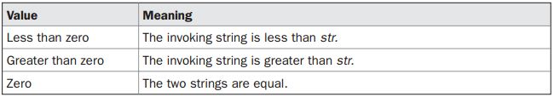
String Comparison
compareTo( ):
A string is less than another if it comes before the other in dictionary order.
A string is greater than another if it comes after the other in dictionary order.
int compareTo(String str)

Slide 32
Example: string sorting
//Sorting string
class Test {
static String arr[] = {“today", "is", "the", "time"};
public static void main(String args[]) {
for (int j = 0; j < arr.length; j++) {
for (int i = j + 1; i < arr.length; i++) {
if (arr[i].compareTo(arr[j]) < 0) {
String t = arr[j];
arr[j] = arr[i];
arr[i] = t;
}
}
System.out.println(arr[j]);
}
}
}
Output:
is
the
time
today

Slide 33
String Comparison
startsWith( ) and endsWith( ):
startsWith( ): determines whether a given String begins with a specified string.
endsWith( ): determines whether the String in question ends with a specified string.
boolean startsWith(String str)
boolean endsWith(String str)
String s="Aman";
System.out.println(s.startsWith("Am"));//true
System.out.println(s.endsWith("n"));//true

Slide 34
Searching Strings
The String class provides two methods that allow us to search a string for a specified character or substring:
indexOf( ): Searches for the first occurrence of a character or substring.
int indexOf(int ch)
lastIndexOf( ): Searches for the last occurrence of a character or substring.
int lastIndexOf(int ch)
To search for the first or last occurrence of a substring, use
int indexOf(String str)
int lastIndexOf(String str)

Slide 35
We can specify a starting point for the search using these forms:
int indexOf(int ch, int startIndex)
int lastIndexOf(int ch, int startIndex)
int indexOf(String str, int startIndex)
int lastIndexOf(String str, int startIndex)
Here, startIndex specifies the index at which point the search begins.
For indexOf( ), the search runs from startIndex to the end of the string.
For lastIndexOf( ), the search runs from startIndex to zero.

Slide 36
Example
class Test {
public static void main(String args[]) {
String s = "Welcome to the Java";
System.out.println(s);
System.out.println(s.indexOf('t'));
System.out.println(s.lastIndexOf('a'));
System.out.println(s.indexOf("the"));
System.out.println(s.indexOf('a', 10));
System.out.println(s.lastIndexOf('a', 18));
}
}
Welcome to the Java
8
18
11
16
18

Slide 37
Modifying a String
String objects are immutable,
modify a String, will construct a new copy of the string.
substring(): used to extract a part of a string.
public String substring (int start_index)
public String substring (int start_index, int end_index)
Example: String s = “ABCDEFG”;
String t = s.substring(2); System.out.println (t);
String u = s.substring (1, 4); System.out.println (u);
Note: Substring from start_index to end_index-1 will be returned.

Slide 38
public class Test
{
public static void main(String args[])
{
String s="SachinTendulkar";
System.out.println(s.substring(6));
//Tendulkar (Starting index)
System.out.println(s.substring(0,6));
//Sachin
}
}

Slide 39
replace( ): The replace( ) method has two forms.
The first replaces all occurrences of one character in the invoking string with another character.
String replace(char original, char replacement)
Here, original specifies the character to be replaced by the character specified by replacement.
Example: String s = "Hello".replace('l', 'w');
The second form of replace( ) replaces one character sequence with another. It has this general form:
String replace(CharSequence original, CharSequence replacement)

Slide 40
Example:
public class Test
{
public static void main(String args[])
{
String s1="Java is an programming language";
String replaceString=s1.replace("an","a");
System.out.println(replaceString);
}
}
Output: Java is a programming laguage

Slide 41
trim( )
returns a copy of string with leading and trailing whitespace has been removed.
String trim( )
Example:
String s = " Hello World ".trim();
This puts the string “Hello World” into s.
The string trim() method eliminates white spaces before and after string.

Slide 42
Changing the Case of Characters Within a String
toLowerCase() & toUpperCase()
Both methods return a String object that contains the uppercase or lowercase equivalent of the invoking String.
String toLowerCase( )
String toUpperCase( )

Slide 43
public class Test
{
public static void main(String args[])
{
String s=" Aman ";
System.out.println(s);// Aman
System.out.println(s.trim());//Aman
System.out.println(s.toUpperCase());
System.out.println(s.toLowerCase());
System.out.println(s);
}
}
Aman
Aman
AMAN
aman
Aman

Slide 44

Notes:
StringExample.java

